Slide 1
Periodic Classification Of Elements
Introduction
Need for classification

Slide 2



1
2
Systematic arrangement of clothes have been done, so shopping becomes easy
Which place will you choose for a quick shopping???
Why ???

Slide 3



1
2
From where would you get the required book easily???
Systematic arrangement of books have been done.
Why ???

Slide 4
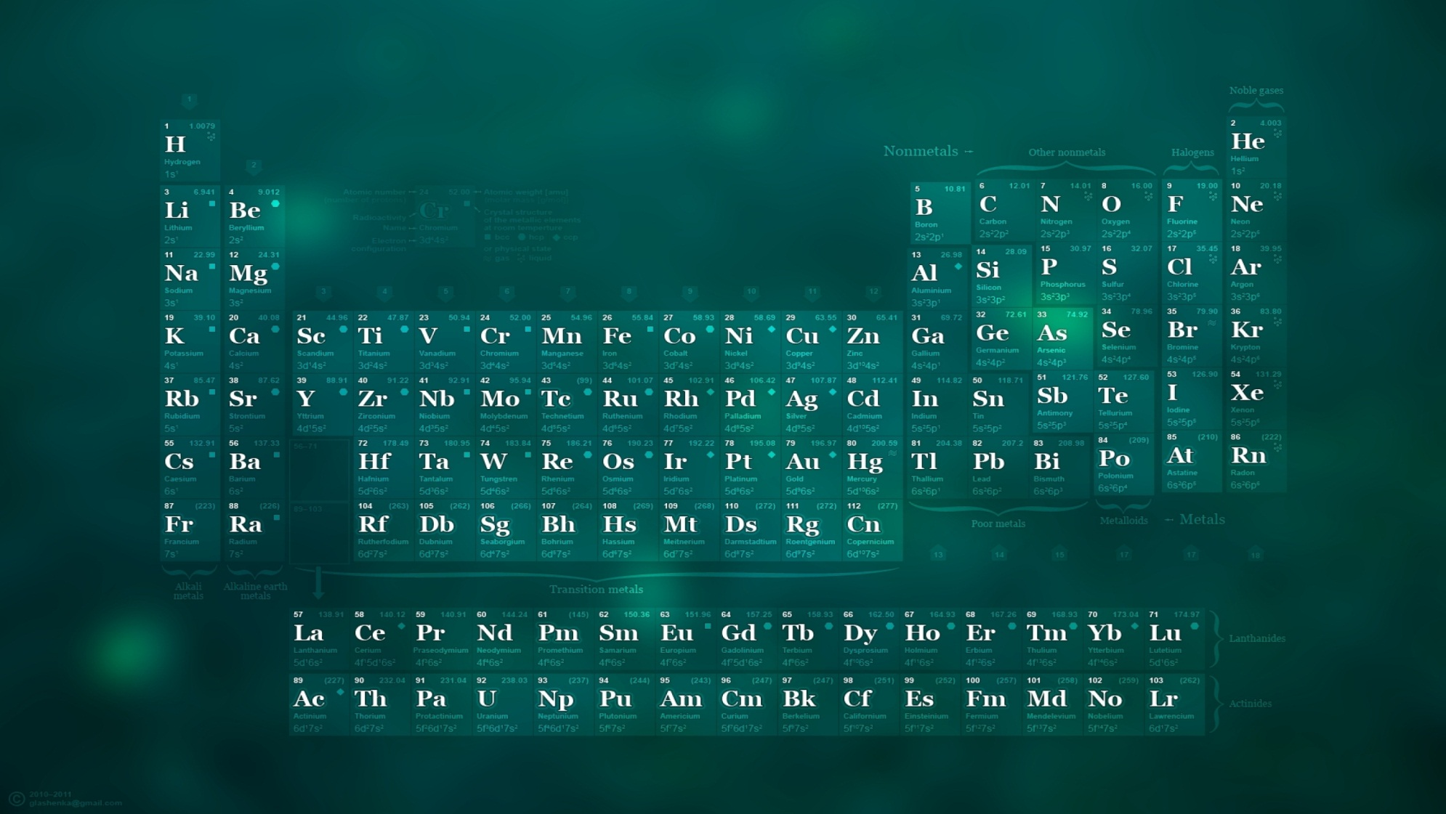
The most fundamental
matter in Chemistry
are “Elements”.
An element is a type of matter composed of only one kind of substance.

Slide 5

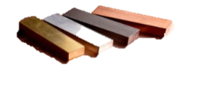


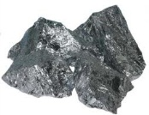


Initially scientists discovered elements like gold, silver, carbon(coal), sulphur, iron and copper.
Some elements showed properties of both metals and non-metals which were known as Metalloids
????
They classified them as metals and non-metals.
Metals
Non-metals
COPPER, SILVER, IRON
CARBON(COAL)
SILICON
GOLD
SULPHUR

Slide 6
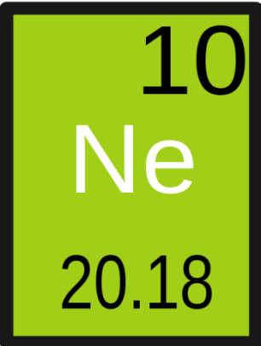
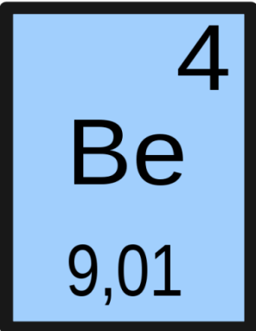
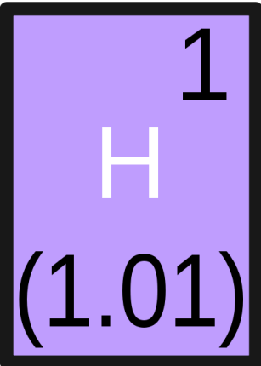
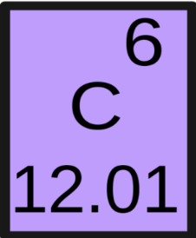
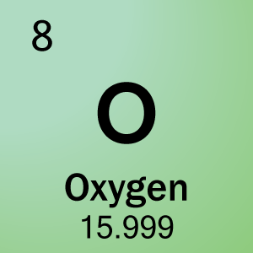
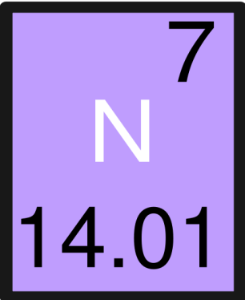
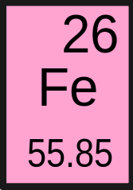
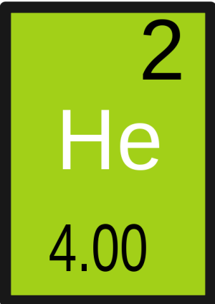
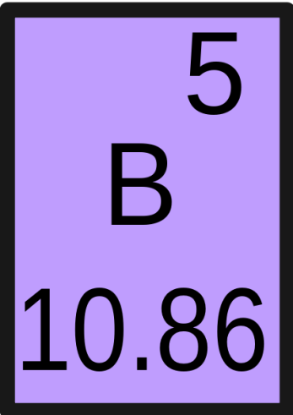
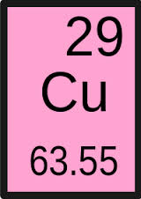
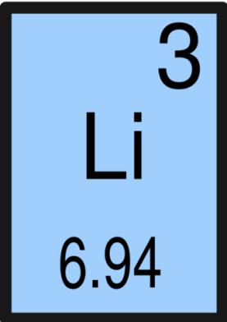
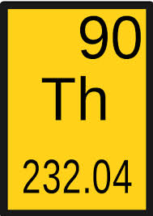
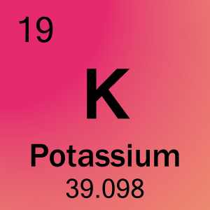
Today there are 119 elements.
There was a need of systematic classification and arrangement of these elements to make their study easy.
Let’s study efforts of classification in the chapter ……..

Slide 7
Periodic Classification Of Elements
Dobereiner’s law of triads
Limitations of Dobereiner’s law of triad

Slide 8
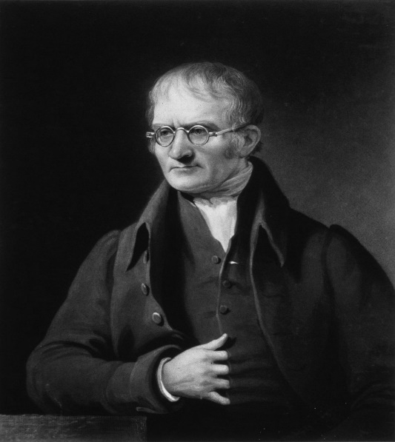
John Dalton
The real journey of classification started
from the year 1808
He proposed the atomic theory
According to atomic theory, every atom
has mass. So, he said atomic mass is the fundamental characteristic of every atom
English Chemist
8

Slide 9
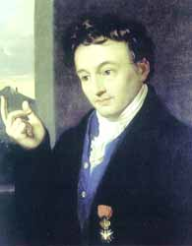
Johann Wolfgang Dobereiner
In earlier attempts, the elements were classified on the basis of their properties. All the elements having similar properties were put in one group called a family.
Tried to classify the elements for the first time, based on the atomic theory given by Dalton.
German Chemist
9

Slide 10
Dobereiner’s Law Of Triads
He arranged chemically similar elements
In a Triad, atomic mass of middle element is approximately the mean of atomic masses of other two elements.
Li Na K
are chemically similar elements
In the increasing order of their atomic masses
Statement of the law is as follows
The mean was approximately equal to the atomic mass of middle element
In a group of three
Then he calculated the mean of atomic masses of first and the last element of the triad.
Known as Dobereiner’s Triads
Arranged in increasing order of their atomic masses
E.g.
Elements
Lithium
Sodium
Potassium
Symbols
Li
Na
K
Atomic masses
6.9
23.0
39.0
For example:
All these elements are metals
All of them react with water to form alkalis and hydrogen gas
All of them have a valency of 1
6.9 + 39
2
=
45.9
2
=
22.95

Slide 11
Elements
Calcium
Strontium
Barium
Symbols
Ca
Sr
Ba
The mean was approximately equal to the atomic mass of middle element
Hence, this triad followed the law
For example:
All these elements are metals
The oxides of all them are alkaline in nature
All these elements have a valency of 2
Hence, this triad does not follow the Law
Ca Sr Ba
are chemically similar elements
Atomic masses
40.1
87.6
137.3
N P As
Are chemically similar elements
The mean was not equal to the atomic mass of the middle element
Then he calculated the mean of atomic masses of first and the last element of the triad.
Arranged in increasing order of their atomic masses
Arranged in increasing order of their atomic masses
40.1 + 137.3
2
177.4
2
=
=
88.7
Then he calculated the mean of atomic masses of first and the last element of the triad.
Elements
Nitrogen
Phosphorus
Arsenic
Symbols
N
P
As
Atomic masses
14.0
31.0
74.9
14.0 + 74.9
2
88.9
2
=
=
44.45

Slide 12
Limitations of Dobereiners Law Of Triads
Dobereiner could identify only few triads from the elements
known at that time, other triads did not obey Dobereiner’s rule. Hence, the system of triads was not useful.
FAILED

Slide 13
Periodic Classification Of Elements
Newlands’ law of octaves
Features of newlands’ law of octaves

Slide 14
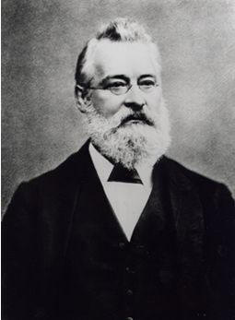
John Newlands
After the failure of Dobereiner’s triad, the next attempt to classify elements was done in the year 1864.
By this time, 56 elements were discovered. Newlands arranged all these elements in an increasing order of their atomic masses.
English Scientist

Slide 15
Elements
Symbols
Elements
Symbols
Hydrogen
H
Aluminium
Al
Lithium
Li
Silicon
Si
Beryllium
Be
Phosphorous
P
Boron
B
Sulphur
S
Carbon
C
Chlorine
Cl
Nitrogen
N
Potassium
K
Oxygen
O
Calcium
Ca
Fluorine
F
Sodium
Na
Magnesium
Mg

Slide 16
Newlands’ Law Of Octaves
H
Li
Be
B
C
N
O
F
Na
Mg
Al
Si
P
S
Cl
K
Ca
Increasing order of atomic mass
When the elements are arranged in an increasing order of their atomic masses, the properties of the eighth element are similar to the first.
He observed that the properties of every eighth element was similar to the first. So he kept similar elements one below the other.
He found that properties of Fluorine(F) were similar to Hydrogen (H), So he placed it below H
He studied physical &
chemical properties of
these elements
He compared
this to musical notes
Sa (do) | Re (re) | Ga (mi) | Ma (fa) | Pa (so) | Dha (la) | Ni (ti)

Slide 17
Features Of Newlands’ Table
Newlands knew 56 elements.
After Calcium every eighth element did not possess properties similar to that of first.
Two elements with different properties placed in the same box.
Sa
(do)
Re
(re)
Ga
(mi)
Ma
(fa)
Pa
(so)
Da
(la)
Ni
(ti)
Sa
(do)
Re
(re)
Ga
(mi)
Ma
(fa)
Pa
(so)
Da
(la)
Ni
(ti)
Iron element (Fe) which resembles cobalt and nickel elements in properties, was placed far away from these elements.
Sa
(do)
Re
(re)
Ga
(mi)
Ma
(fa)
Pa
(so)
Da
(la)
Ni
(ti)
H
Li
Be
B
C
N
O
H
Li
Be
B
C
N
O
F
Na
Mg
Al
Si
P
S
H
Li
Be
B
C
N
O
F
Na
Mg
Al
Si
P
S
This table did not include inert gases because they were not yet discovered.
F
Na
He didn’t explain why
2 elements were kept together
Cl
K
Mg
Ca
Al
Si
P
S
Cl
K
Ca
Cr
Ti
Mn
Fe
Cl
K
Ca
Cr
Ti
Mn
Fe
Co & Ni
Cu
Zn
Y
In
As
Se
Co & Ni
Cu
Zn
Y
In
As
Se
Br
Rb
Sr
Ce & La
Zr
Br
Rb
Sr
Ce & La
Zr

Slide 18
Periodic Classification Of Elements
Mendeleev’s periodic classification
Features of periodic classification

Slide 19
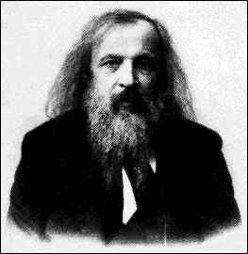
Dimitri Ivanovitch Mendeleev
After the failure of Newlands’ law of octaves, the next attempt to classify elements was done in the year 1869
Called as father of classification. He also arranged elements according to their atomic masses
Russian Chemist

Slide 20
Most important contributor in classification of elements.
Mendeleev knew 63 elements.
He classified elements on the basis of Atomic masses
Since formula of these oxides is same, Mendeleev placed all of them in the same group
And studied their physical & chemical properties.
Mendeleev took the formulae of the oxides and hydrides formed by the elements as the basic property of elements for their classification in the form of a periodic table.
Formula for beryllium oxide is BeO
Formula for magnesium oxide is MgO
Formula for calcium oxide is CaO
H
He arranged elements horizontally if they were dissimilar and vertically if they were similar in their chemical properties
After Calcium the known element was Titanium but it was not similar to Aluminum. So he placed it below Silicon which was similar to it. Hence he left vacant space
Li
Be
B
C
N
O
F
Na
Mg
Al
Si
P
S
Cl
K
Ca
Ti
V
Cr
Mn
Fe
Co
Ni
Cu

Slide 21
On the basis of this Mendeleev formulated a PERIODIC LAW.
The physical and chemical properties of elements are a Periodic function of their “Atomic masses”
Phenomenon which is repeated
after regular interval of time is
called PERIODIC E.g. sunrise
& sunset
The tabular arrangement of the elements based on the periodic law is called the Mendeleev’s Periodic Table.
There are 8 groups numbered from I to VIII, groups I to VII are further divided into A & B sub groups
Horizontal rows in the periodic table are called PERIODS.
G
R
O
U
P
S
PERIODS
Vertical columns in the periodic table are called GROUPS
There are 7 periods numbered from 1 to 7.

Slide 22
Main Features Of Mendeleev’s Periodic Table
The horizontal rows in the periodic table are called periods. There are seven periods. These are numbered from 1 to 7
Properties of elements in a particular period show REGULAR GRADATION from left to right.
Vertical columns in the periodic table are called groups. There are eight groups numbered from I to VIII. Groups I to VII are further divided into A and B subgroups.
As we go from left to right, you can see a slow variation in the properties of elements from metals to nonmetals
Li Be B C N O F
Metals
Non metals
Metalloid

Slide 23
Periodic Classification Of Elements
Merits of Mendeleev’s periodic table
Demerits Mendeleev’s periodic table

Slide 24
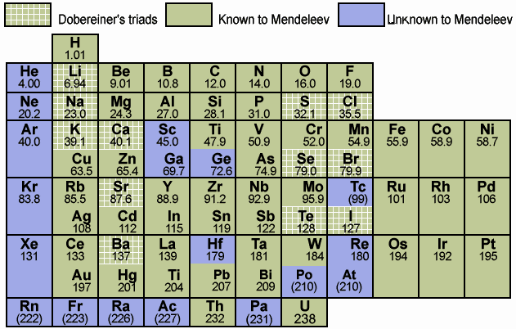
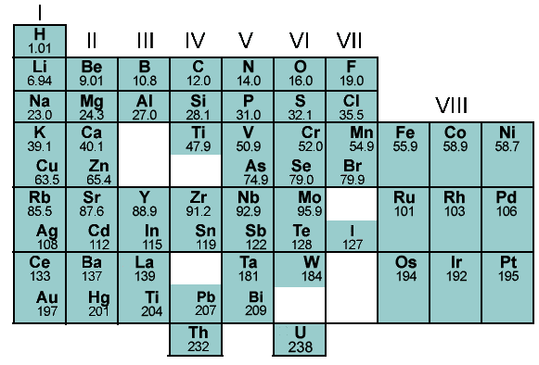

Merits Of Mendeleev’s Periodic Table
Mendeleev was the first who successfully classified all known elements.
Kept vacant spaces for elements yet to be discovered. Also predicted properties of these elements.
Later they were found to be correct.
When noble gases were discovered later, they were placed in the table without disturbing the position of other elements.
Eka means alternate
Eka - boron
Eka- silicon
They were named as Eka-boron ,Eka-aluminium &
Eka-silicon
Predicted elements
Elements discovered
Eka-boron
Scandium
Eka-aluminium
Gallium
Eka- aluminium
Eka-silicon.
Germanium

Slide 25
Comparison Of Properties Of Eka-Aluminium And Gallium
This table confirms that predicted elements & discovered elements are similar .
Eka-aluminium
Gallium
Atomic weight
About 68
69.72
Density of solid
6.0g/cm³
5.9g/cm³
Melting point
Low
29.78⁰C
Low – approximate
room temperature
Valency
3
3
Method of
discovery
Probably from
spectrum
Spectroscopic
ally
Oxides
Ea₂O₃
Ga₂O₃

Slide 26
Demerits Of Mendeleev’s Periodic Table
Group IA
Hydrogen resembles alkali metals as well as halogens. Therefore, no fixed position given to hydrogen in periodic table.
¹⁶O, ¹⁸O
Elements with higher atomic mass were placed before elements with lower atomic mass.
Group VIIA
Isotopes are atoms of same elements with different atomic mass and therefore should be given different position. But they are chemically similar and hence they should be given same position. Among other isotopes of oxygen only ¹⁶O was placed.
elements with different properties placed together. Ex. Manganese which is a metal placed along with nonmetals (halogens).

Slide 27
Periodic Classification Of Elements
Modern periodic table
Layout of modern periodic table

Slide 28

Henry Moseley
He studied the demerits of previous attempts of classification and discovered that Atomic number(Z)
is the most fundamental property of an element and not its atomic mass.
No. of protons or electrons
Moseley found that electrons take part in a chemical reaction and not protons.
ENGLISH
PHYSICIST

Slide 29
Discovery of atomic number changed the whole perspective about elements and their properties.
Accordingly, Mendeleev’s periodic law was modified into ‘Modern Periodic Law’.
MENDELEEV’S PERIODIC LAW
MODERN PERIODIC LAW
The chemical and physical properties of elements are a Periodic function of their
“Atomic masses”.
“Atomic Numbers”.
The periodic table based on modern periodic law is called the Modern Periodic Table.

Slide 30
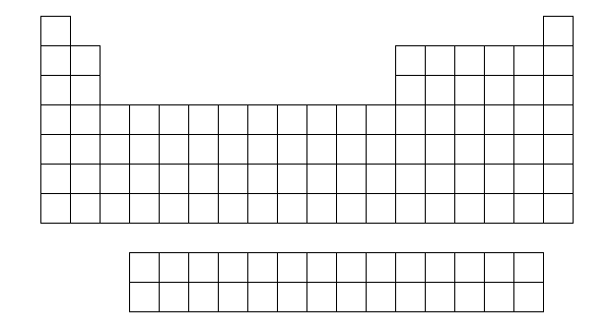
Layout Of Modern Periodic Table
Long form of periodic table
Horizontal rows in the periodic table are called Periods.
G
R
O
U
P
S
Vertical columns in the periodic table are called Groups.
In order to place all the known elements Moseley added many more groups hence it is called long form of periodic table
PERIODS
In modern periodic table there are 18 groups, 7 periods and 2 additional series at the bottom of the periodic table

Slide 31
Periodic Classification Of Elements
Modern periodic table

Slide 32
Modern Periodic Table
1
In modern periodic table elements are arranged in increasing order of atomic number
18
Let’s place first 18 elements from Hydrogen to Argon
So let’s put atomic number from 1 to 116 in each box
1
Other way is just to number from 1 to 18
H
Now fill up group IA, IIA, VIIA & zero group
zero
1
All tall columns are labelled as A & short columns as B
There are two ways to number groups
2
Periods are numbered from
1 to 7
Since 6th period contains
18 + 14 lanthanides which is equal to 32 elements,
so it is called
2
Shortest Period (2)
13
14
15
16
17
He
IA
Since 7th period is not complete it is called…
IIA
IIIA
IVA
VA
VIA
VIIA
3
4
Since 4th & 5th period contains 18 elements each, so it is called
Short Periods (8)
5
6
7
8
9
10
2
Li
Be
B
C
N
O
F
Ne
3
4
14 elements with atomic numbers 90 to 103 are actinides and are placed along with actinium in the same group 3 in period 7 because of very close resemblance in properties
11
12
5
6
7
8
9
10
11
12
13
14
15
16
17
18
14 elements with atomic number 58 to
71 are called as lanthanides and are placed along with lanthanum in the same group
3 in period 6 because of very close resemblance in properties
3
Na
Mg
14 elements post Lanthanum are arranged at the bottom of the periodic table in the form of a series called Lanthanide series.
Al
Si
P
S
Cl
Ar
IIIB
IVB
VB
VIB
VIIB
← VIII →
IB
IIB
Lanthanide series starts from atomic number 58 to 71
Since 1st period contains only 2 elements, so it is called
Actinide series starts from atomic number 90 to 103
14 elements post Actinium are arranged at the bottom of the periodic table in the form of a series called as
Actinide series.
19
20
21
22
23
24
25
Since 2nd & 3rd period contains 8 elements each, so it is called
26
27
28
29
30
31
32
33
34
35
36
4
K
Ca
Long Period (18)
Br
Kr
37
38
39
40
41
42
43
44
45
46
47
48
49
50
51
52
53
54
5
Rb
Sr
I
Xe
56
57-71
55
La-
Lu
72
73
74
75
76
77
78
79
80
81
82
83
84
85
86
6
Cs
Ba
La
Longest Period (32)
At
Rn
87
88
89-103
Ac-
Lr
104
105
106
107
108
109
110
111
112
113
114
115
116
7
Fr
Ra
Ac
Incomplete Period
Ce
Lanthanides (14)
Lu
Th
Lr
Th
Actinides (14)
Lr

Slide 33
Periodic Classification Of Elements
Classification of elements in groups
Characteristics of group I and II

Slide 34
Groups Of Modern Periodic Table
^{Light Metals}
1
^{Non - Metals}
zero
Now lets understand each block
1
1
18
H
IIA
Heavy Metals
2
2
IIIA
IVA
VA
VIA
VIIA
He
13
14
15
16
17
2
3
4
5
6
7
8
9
10
Li
Be
C
N
O
F
Ne
3
11
12
IVB
VB
VIB
VIIB
←VIII→
IB
IIB
18
Na
Mg
Ar
3
4
5
6
7
8
9
10
11
12
4
Kr
5
6
7
La
Ac

Slide 35
Group 1 & 2
1
1
H
IIA
Lets take electronic configuration of Na & Mg
IA
2
2
3
4
All the elements in group 1 and 2 will have either 1 or 2 electrons in the outermost orbit
Li
Be
11
12
3
Na
Mg
(2,8,1)
(2,8,2)
All of them in order to become stable donate electrons. Therefore all are metals except hydrogen
4
5
6
Since, only outermost shell is incomplete they are called as ‘Normal elements’.
7

Slide 36
Groups 13 to 18
1
zero
Right hand side of zig-zag line are all non-metals and on left hand side all metals. And on the border all metalloids are present.
18
Lets take electronic configuration of few elements in this block
2
2
IIIA
IVA
VA
VIA
VIIA
He
13
14
15
16
17
All the elements in this block contains 3 to 8 electrons in the outermost orbit
5
6
7
8
9
10
B
C
N
O
F
Ne
B
(2,3)
(2,4)
(2,5)
(2,6)
(2,7)
(2,8)
Si
18
Ar
Zig-zag line in this block divides entire periodic table into two parts
Ge
As
NON-METALS
Sb
Te
METALS
This block contains metals, non-metals
Chemically inactive
Po
as well as metalloids
This block contains normal as well as inert elements.

Slide 37
Periodic Classification Of Elements
Transition elements
Inner transition elements

Slide 38
Groups 3 to 12
Group 3 to 12 are known as heavy metals.
IIIB
IVB
VB
VIB
VIIB
←VIII→
IB
IIB
3
4
5
6
7
8
9
10
11
12
These elements have last two shells incomplete
Fe(2, 8, 14, 2)
All these elements are metals since they are on the left hand side of the zig-zag line
They are known as transition elements

Slide 39
Lanthanide & Actinide Series
Elements present at the bottom of the periodic table is called as lanthanides and actinides series.
They have their last 3 shells incompletely filled. They are metals.
They are also known as inner transition elements.
Ce
Lu
Th
Lr

Slide 40
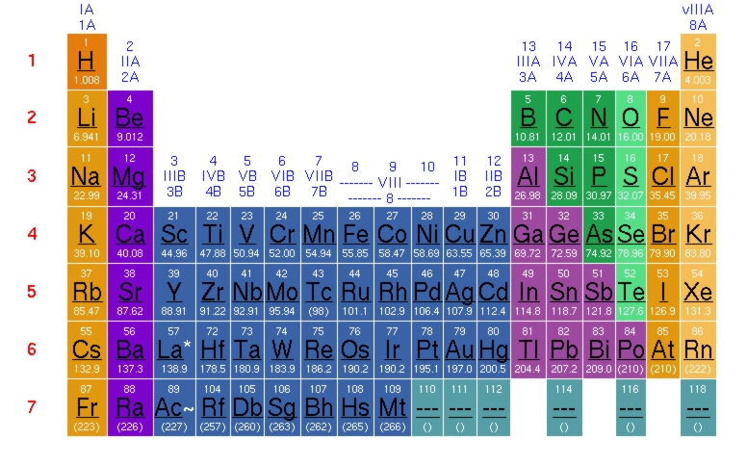
Similarities Between Hydrogen And Alkali Metals
Elements of
Gr IA
Atomic
No.
Electronic configuration
Electronic configuration:
they have only one electron in their outermost orbits.
Group I A elements
are called as alkali
metals
K
L
M
N
O
P
Q
H
1
1
Valence electrons: all the elements have one electron in their outermost orbit so all of them have 1 valence electron.
Li
3
2
1
Na
11
2
8
1
K
19
2
8
8
1
Rb
37
2
8
18
8
1
Valency: all alkali metals including hydrogen have valency.
Cs
55
2
8
18
18
8
1
Fr
87
2
8
18
32
18
8
1

Slide 41
Similarities Between Hydrogen And Halogens
1. Electronic configuration:
Hydrogen as well as halogens have one electron less than the nearest
inert gas.
Halogens
E.C
Inert Gas
E.C
H
(1)
He
Group VII A elements
are called as
halogens
(2)
F
(2,7)
Ne
(2,8)
Cl
(2,8,7)
Ar
(2,8,8)
As hydrogen has 1
electron less as compared
to helium in its valence
shell, similarity F has 1
electron less than that
of Ne
2. Valency:
Both have a valency of 1. They take one
electron to attain the nearest inert gas
electronic configuration.

Slide 42
Periodic Classification Of Elements
Merits of Modern periodic table
Periodic properties

Slide 43
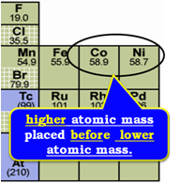
Merits Of Modern Periodic Table
All isotopes of the same elements occupy the same position in the modern periodic table .
Since the elements are arranged according to their atomic number, the anomalies regarding certain pairs of elements in Mendeleev's periodic table disappears. E.g. Atomic number of cobalt and nickel are 27 and 28 respectively. Therefore cobalt will come first due to its atomic number and then nickel although its atomic mass is greater.
Elements are classified according to their electronic configuration into different blocks.

Slide 44
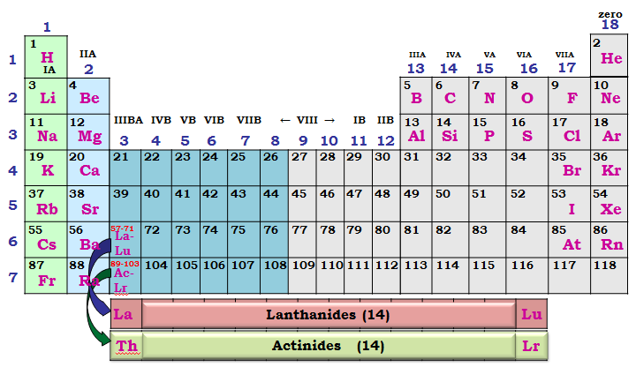
Common Name For Important Groups
Alkali metals
Inert gas
Group IA elements are called Alkali metals
Hydrogen is an exception
Halogens
Alkaline earth metals
Oxides of these metals are basic in nature & they are found in earth’s crust
Zero Group elements are called inert gases
Group VIIA elements are called halogens
Group IIA elements are called Alkaline earth metals
Oxides of these metals are soluble in water & they are basic in nature
They are chemically inactive
They are sea salt generators
Ce

Slide 45
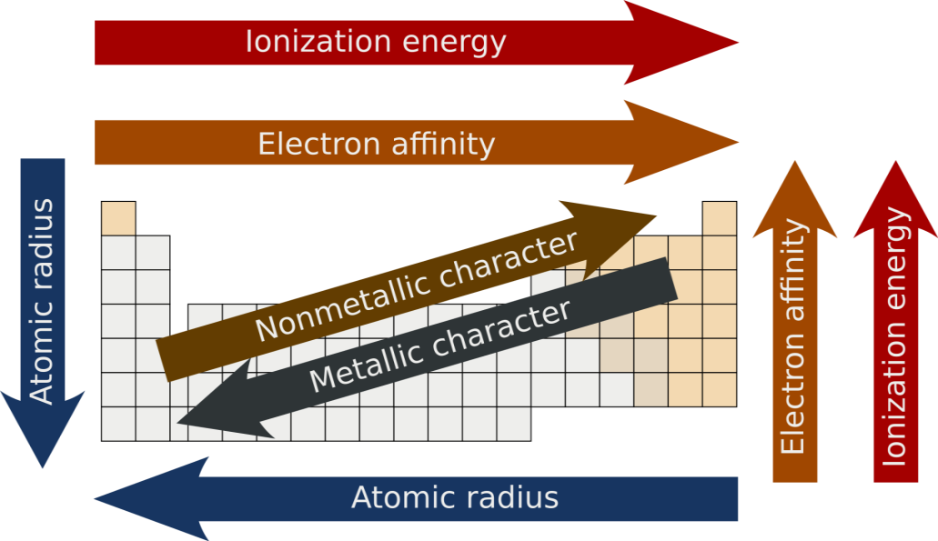
Characteristics Of Periods And Groups
The properties which show gradual variation in a group and in a period and they repeat themselves after a certain interval of atomic number are called periodic properties.
1. Valency
2. Atomic size
3. Metallic & non-metallic
properties

Slide 46
Periodic Classification Of Elements
Valence electrons
Board Questions

Slide 47
Valence Electrons (Or Outermost Electrons)
On moving from left to right in a period , the number of valence electrons in elements increases from 1 to 8
Elements of
third period
11
Na
12
Mg
13
Al
14
Si
15
P
16
S
17
Cl
18
Ar
Electronic
configurations
2,8,1
2,8,2
2,8,3
2,8,4
2,8,5
2,8,6
2,8,7
2,8,8
Number of
Valence electrons
1
2
3
4
5
6
7
8
The first element in every period has 1 Valence electron and the last element in every period has 8 valence electron (except in the first period where last element helium has only 2 valence electrons)

Slide 48
Valence Electrons (Or Outermost Electrons)
All the elements of a group of the periodic table have the same
Number of valence electrons.
Since all the elements in a group have similar electronic configuration having the same number of valence electrons they show similar chemical properties
Group
1
Electronic
configuration
No. of valence
electrons
Li
2, 1
1
Na
2, 8, 1
1
K
2, 8, 8, 1
1
On moving down in a particular group of the periodic table, the number of valence electrons in the elements remains the same.

Slide 49
How to find the group number of an element in the periodic.
table from the number of valence electrons in its atom.
The group number of elements having up to two valence electrons is equal to the number of valence electrons.
There is, however, one exception to this rule. The noble gas ‘helium’ has 2 valence electrons in K shell but its group number is 18.
If number of valence electrons is 1, then group number is 1
If number of valence electrons is 2, then group number is 2
ii) The group number of elements having up to two valence electrons is equal to the number of valence electrons plus 10.
If number of valence electrons is 3, then group number is 3+10=13
If number of valence electrons is 4, then group number is 4+10=14
If number of valence electrons is 7, then group number is 7+10=17

Slide 50

The electronic configuration of an element X is: K L M
2, 8, 6
5 mark
Questions
What is the group number of element X in the periodic table?
Ans: From the above given electronic configuration we find that element X has 6 valence electrons in the outermost shell so the group number of element X in periodic table is 6+10=16.
What is the group number of element X in the periodic table?
What is the period number of element X in the periodic table?
What is the number of valence electrons in an atom of X?
What is the valency of X?
Is it a metal or a non metal?
ii) What is the period number of element X in the periodic table?
Ans: Element X has 3 electron shells (K,L and M) in its atom, so the period number of X is 3. That is , X belongs to 3rd period of the periodic table.
iii) What is the number of valence electrons in an atom of X?
Ans: Elements X has 6 valence electrons.

Slide 51
The electronic configuration of an element X is: K L M
2, 8, 6
5 mark
question
iv) What is the valency of X?
Ans: Elements X has 6 valence electrons so it needs 2 more electrons to complete its octet 8 electrons in valence shell and become stable. Thus, the valency of element X is 2.
v) Is it a metal or a non metal?
Ans: The elements of group 16 are
non-metals. So, X is a non-metal.

Slide 52
An element X is in group 13 of the periodic table. What is the
formula of its oxide?
5 mark
Questions
Solution:
We know that the element aluminium belongs to group 13 of the periodic table and has a valency of 3. So, the element X of the above given problem could be aluminium, Al and the oxide X₂O₃ could be actually aluminium oxide, Al₂O₃.
In order to write down the formula of the oxide of element X, we should know its valency. The valency of group 13 elements is 3. So, the valency of element X is 3. We already know that the valency of oxygen is 2.This give us the following conclusions:
Element Valency
X 3
O 2
Since the valency of element X is 3 and that of O is 2, two atoms of X will combine with three atoms of O to form an oxide X₂O₃.
Thus, the formula of oxide of element X is X₂O₃.

Slide 53
Periodic Classification Of Elements
Valency

Slide 54

Valency
Group number indicates the number of valence electrons
[electrons in the outermost orbit].
The valency of an element is determined by the number of valence electrons.
C & Si contains 4 electrons in their outermost shell, to become stable it is easier for them to share electrons. So their valency is
Valency increases from 1 to 4 for the second & third period and then decreases from 4 to 0 when you go from left to right in the table.
Lets consider elements of first 3 periods with their atomic number &
electronic configuration.
The period number indicates the number of shells
They are already stable so their valency is
All the elements of a group have the same number of valence electrons. Therefore, they have the same valency.
Na, Mg & Al contains 1, 2 & 3 electrons respectively in their outermost shell, to become stable it is easier for them to donate electrons. So their valency is
1
P, S & Cl contains 5, 6 & 7 electrons respectively in their outermost shell, to become stable it is easier for them to accept electrons. So their valency is
What these elements will do??
18
Give, Take or
Share electrons?
1
1
H
2
He
(K)
(1)
2
13
14
15
16
17
(2)
IA
IIA
IIIA
IVA
VA
VIA
VIIA
Zero
2
3
Li
4
Be
5
B
6
C
7
N
8
O
9
F
10
Ne
(K,L)
(2,1)
(2,2)
(2,3)
(2,4)
(2,5)
(2,6)
(2,7)
(2,8)
11
12
13
14
15
16
17
18
3
Na
Mg
Al
Si
P
S
Cl
Ar
(K,L,M)
(2,8,1)
(2,8,2)
(2,8,3)
(2,8,4)
(2,8,5)
(2,8,6)
(2,8,7)
(2,8,8)
Valency
1
2
3
4
3
2
1
0

Slide 55
Periodic Classification Of Elements
Atomic size in period and group

Slide 56

Atomic Size Across The Period
The term atomic size refers to the radius of an atom.
Atomic radius is the distance between the centre of atom & outermost shell.
₁₁Na
₁₂Mg
₁₃Al
₁₄Si
₁₅P
₁₆S
3
3
3
3
3
3
11
11
r
11
14
15
16
12
13
14
15
16
12
13
_{(2,8,1)}
_{(2,8,2)}
_{(2,8,3)}
_{(2,8,4)}
_{(2,8,5)}
_{(2,8,6)}
_{186 pm}
_{160 pm}
_{143 pm}
_{118 pm}
_{110 pm}
_{104 pm}
As we go from left to right in a period, the nuclear charge increases, thus the pull between the electrons and protons increases. Therefore, the atomic size decreases as we go from left to right.

Slide 57
Atomic Radius Down The Group
F
r = 64pm
2
Atomic radius increases in a group from top to bottom as new shells are added bringing outermost electrons farther from the nucleus
Lets consider the elements of VIIA group
Cl
r =99pm
3
Br
r =114pm
4
I
r=133pm
5

Slide 58
Periodic Classification Of Elements
Metallic & Non-metallic character

Slide 59
Metallic & Non-Metallic Character
Metals have 1,2 or 3 electrons in their outermost orbit. In order to become stable, metals donate electrons & form positive ions (Na⁺, Mg⁺²). Therefore metals are said to be ELECTROPOSITIVE.
Non-metals have 4 – 7 electrons in the outermost orbit. In order to become stable, non-metals share or accept electron & form negative ions (S²⁻, P³⁻).Therefore non-metals are said to be ELECTRONEGATIVE.
Metallic character decrease and non-metallic character increases from left to right in a period.
This is because atomic size decreases. Therefore, the electrons are not
easily released
1st three are
metals
next three are non-metals
₁₁Na
₁₂Mg
₁₃Al
₁₄Si
₁₅P
₁₆S
11
12
13
14
15
16
(2,8,1)
(2,8,2)
(2,8,3)
(2,8,4)
(2,8,5)
(2,8,6)

Slide 60
Metallic & Non-Metallic Character Down The Groups
Lithium
In a group, metallic character increases and non-metallic character decreases from top to bottom. This is because atomic size increases and valence electrons can be easily removed.
Sodium
Lets consider group IA
Potassium
Rubidium

Slide 61
Periodic Classification Of Elements
Chemical Reactivity
Nature of oxides

Slide 62
Chemical Reactivity
On moving from left to right in a period, the chemical reactivity of elements first decreases and then increases.
Third Periods
Elements:
Na
Mg
Al
Si
P
S
Cl
Chemical
Reactivity:
Very
Reactive
Least
Reactive
Very
Reactive
Chemical Reactivity
Chemical Reactivity
Decreases
Increases

Slide 63
Chemical Reactivity
The chemical reactivity of metals increases on going down in a Group of the periodic table.
As we go down in a group of metals, the tendency of their atoms to lose electrons increases, and hence their chemical reactivity also increases.
Li
Least reactive
Lithium
Sodium
Na
Group
17
Chemical reactivity
of metals increases on going down in a group
Potassium
K
F
Most reactive
Rubidium
Rb
Fluorine
The tendency of their atoms to gain electrons decreases due to which their reactivity also decreases
Chlorine
Cl
Chemical reactivity
of non-metals decreases on going down in a group
Cesium
Cs
Fr
Br
Francium
Bromine
Most reactive
I
Iodine
Least reactive

Slide 64
Nature Of Oxides
On going down in a group of the periodic table, there is no change in the nature of oxides of elements.
All the elements of group 1
are metals and metals tend to form basic oxide.
All the elements of group 17
are non-metals and non-metals tend to form
acidic oxide.
Lithium
Li
All the elements of
group1 form basic oxides.
Sodium
Na
Group
17
Potassium
K
Fluorine
F
Rubidium
Rb
Chlorine
Cl
All the elements of group 17 form acidic oxides.
Cesium
Cs
Fr
Br
Francium
Bromine
I
Iodine

Slide 65
Nature Of Oxides
On moving from left to right in a period, the basic nature of oxide decreases and the acidic nature of oxide increases.
Na
Mg
Al
Si
P
S
Cl
Third Periods
Elements:
Nature of
oxide
Highly
basic
Amphoteric
Highly
acidic
Basic nature of oxide
Acidic nature of oxide
Decreases
Increases

Slide 66
Periodic Classification Of Elements
Electron Affinity
Ionisation Potential

Slide 67
Electron Affinity
Trends In Electron Affinity Across A Period From Left To Right
Factors Which Affect The Electron Affinity
Trends In Electron Affinity Down A Group
Atomic Size – Increases
Electron Affinity - Decreases
The amount of energy released when an atom in the gaseous state accepts an electron to form an anion.
Elements
E.A.
[eV]
Trends in electron affinity down a group
ELECTRON
AFFINITY
Elements
Li
(2,1)
Be
(2,2)
B
(2,3)
C
(2,4)
N
(2,5)
O
(2,6)
F
(2,7)
Ne
(2,8)
F
(2,7)
-3.60
Reason: Electron affinity is the tendency of an atom to accept electrons. A small atom takes up electron more readily than a large atom, since nucleus of the atom has the tendency to accept electron.
X
atom
e⁻
electron
ATOMIC RADII Increases
X⁻
anion
Energy liberated
[1st electron affinity.]
UNIT OF
ELECTRON AFFINITY
+
+
ELECTRON AFFINITY
Decreases
DECREASES
E.A. [eV]
-0.61
[exception]
-0.30
-1.25
[exception]
-1.48
-3.6
0
Cl
(2,8,7)
[No. of shells increases]
ATOMIC RADII – Decreases - ELECTRON AFFINITY – Increases
-3.80
Cl⁻
[-3.82 e V]
Electron volt = eV
Cl
+
e⁻
[highest for halogens, least for alkali metals]
Nuclear Charge – Increases
Electron Affinity- Increases
NUCLEAR CHARGE– Increases - ELECTRON AFFINITY – Increases
Br
(2,8,18,7)
NUCLEAR CHARGE
Increases
ELECTRON AFFINITY
Should increase
[represented with –ve sign]
-3.50
Neon [Ne] – has electron affinity zero since-
Noble gases with stable electronic configuration find it difficult to accept electrons.
I (2,8,18,18,7)
Increases in atomic radii dominates over Increases in
nuclear charge
Reason: Nuclear charge increases. Similarly there is an increase in the tendency of the atom to accept electrons.
DOWN
A
GROUP
-3.20
ELECTRON AFFINITY ^{INCREASES} ACROSS A PERIOD – LEFT TO RIGHT
Overall electron affinity - Decreases
67

Slide 68
Trends In Ionisation Potential Across A Period From Left To Right
Trends In Ionisation Potential – Down A Group
Ionisation Potential Or Ionisation Energy
Factors Which Affect The Ionisation Potential
Atomic Size- Increases
Ionisation Potential- Decreases
The amount of energy required to remove a loosely bound electron from the outermost shell of an isolated gaseous atom.
I.P.
[eV]
IONISATION
POTENTIAL
Elements
Li
(2,1)
Be
(2,2)
Trends in ionisation potential down a group
Elements
B
(2,3)
C
(2,4)
N
(2,5)
O
(2,6)
F
(2,7)
Ne
(2,8)
Energy required to remove 1st electron is called first I.P.
Li
(2,1)
UNIT OF IONISATION POTENTIAL
I.P. [eV]
ATOMIC RADII Increases
5.4
9.3
e⁻
electron
IONISATION POTENTIAL
Decreases
8.3
11.2
14.5
13.6
17.4
21.4
M
atom
M⁺
ion
DECREASES
5.4
+
[first I.P. is less]
ATOMIC RADII – Decreases IONISATION POTENTIAL – Increases
Na
(2,8,1)
Energy required to remove 2nd electron is called second I.P.
5.1
[No. of shells increases]
Electron volt = eV
NUCLEAR CHARGE– Increases IONISATION POTENTIAL – Increases
M⁺
M⁺⁺
+
e⁻
[second I.P. is more]
K
(2,8,8,1)
NUCLEAR CHARGE
Increases
IONISATION POTENTIAL
Should increase
Nuclear Charge – Increases
Ionisation Potential- Increases
4.3
IONISATION POTENTIAL ^{INCREASES} ACROSS A PERIOD – LEFT TO RIGHT
Rb (2,8,18,8,1)
Increases in atomic radii dominates over increases in nuclear charge
4.2
Cs
(2,8,18,18,8,1)
3.9
DOWN
A
GROUP
Overall ionisation potential - Decreases

Slide 69
Thank You

